Slide 1
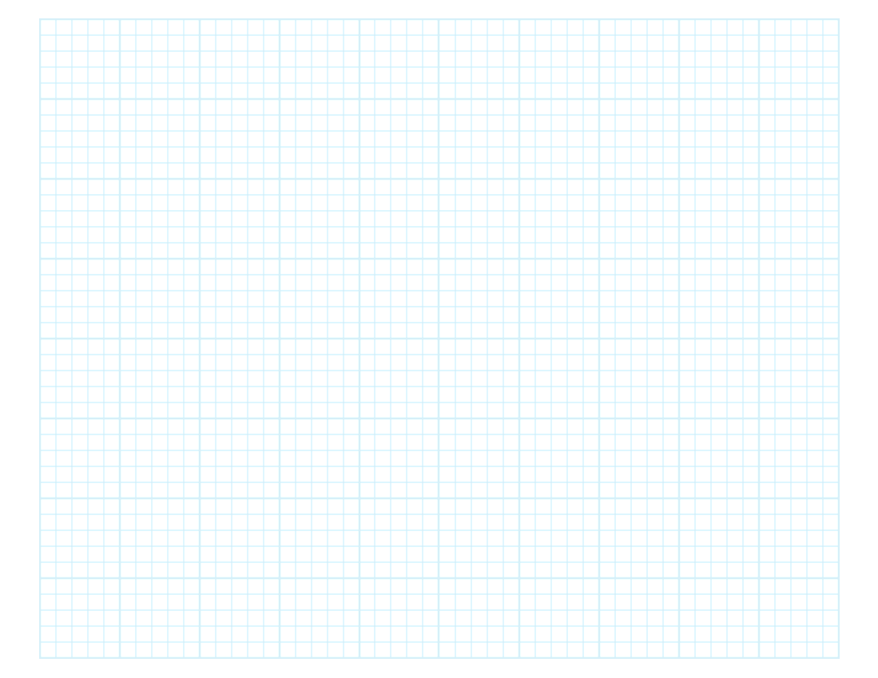

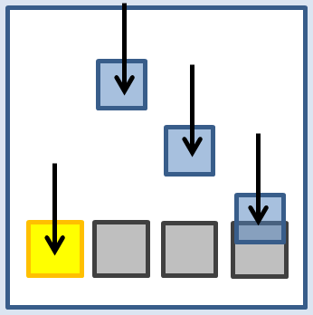
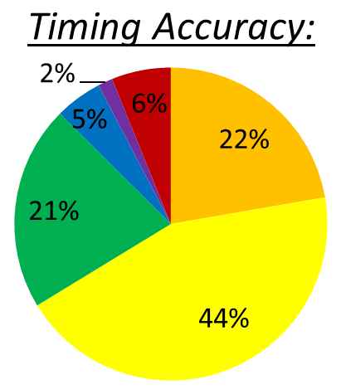
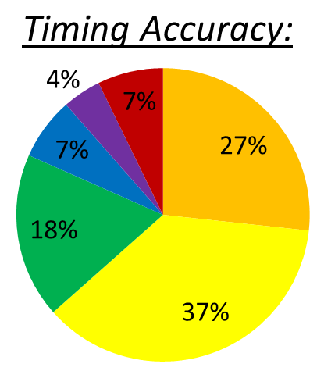
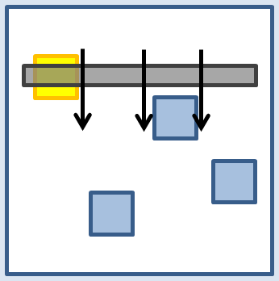




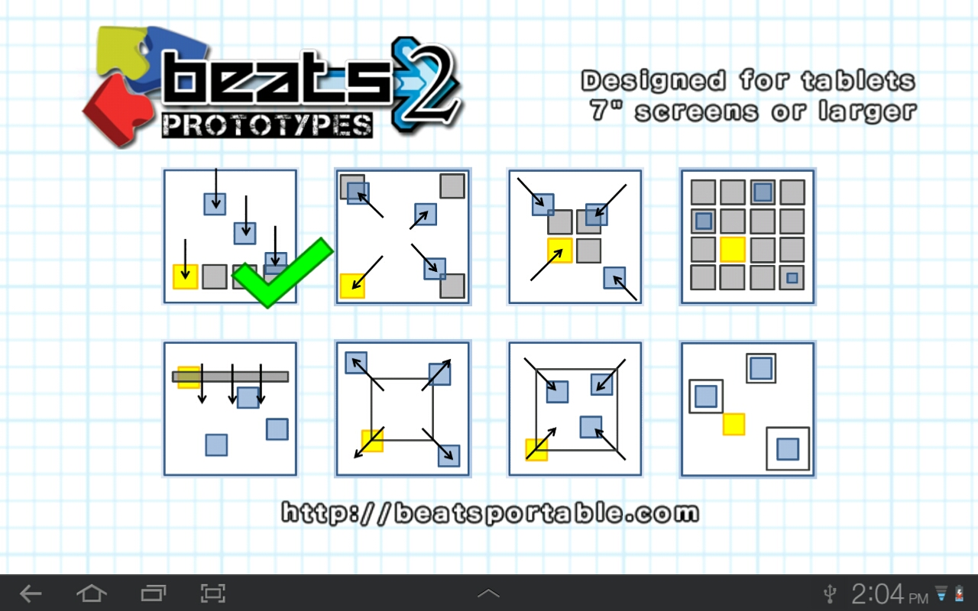
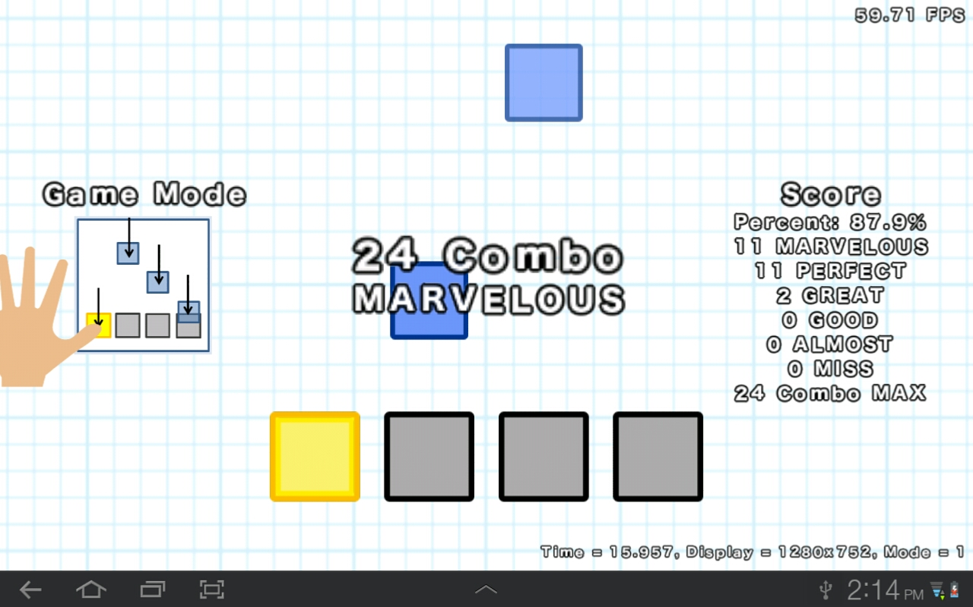
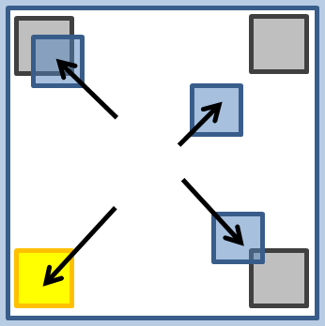
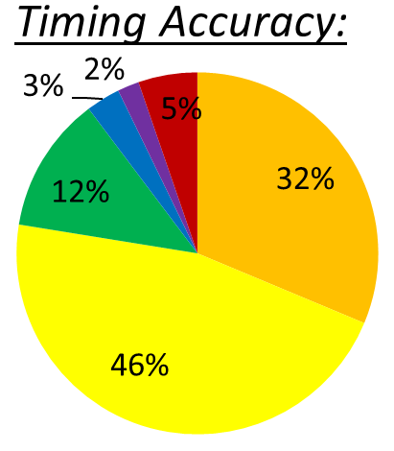
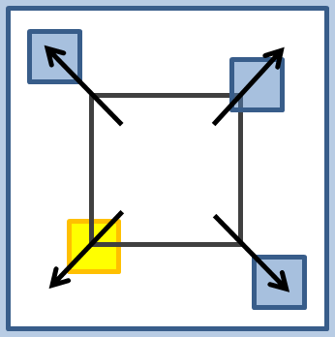
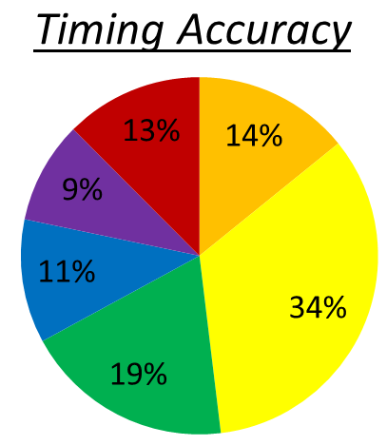
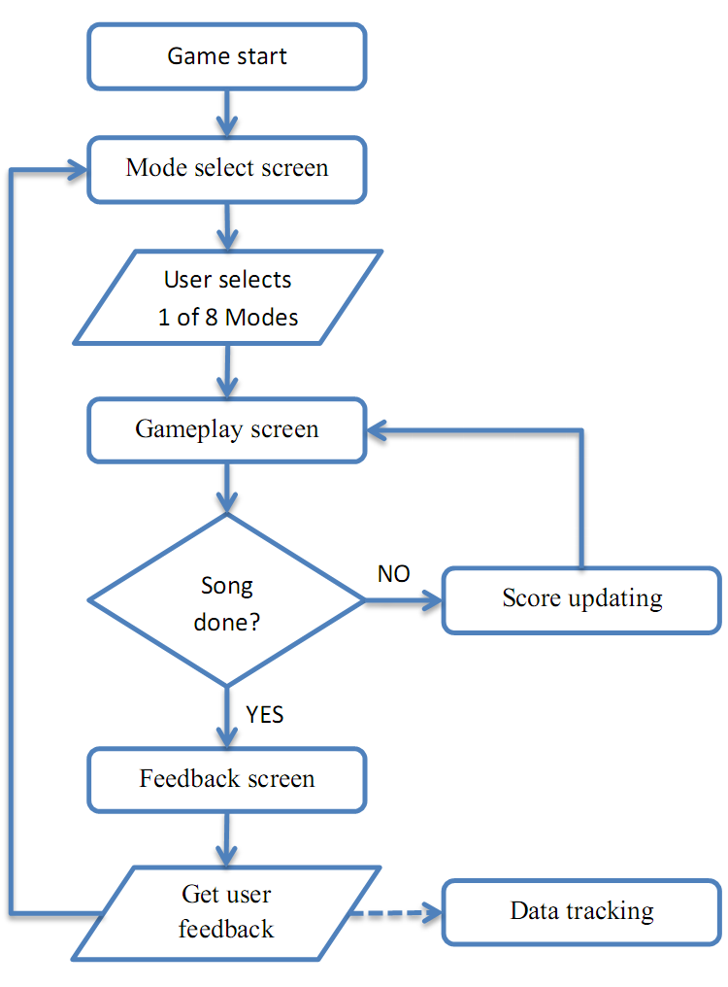
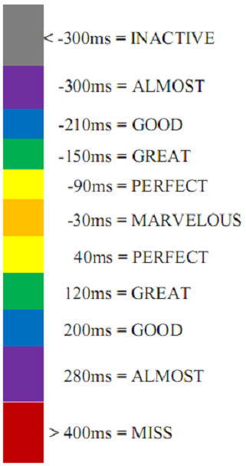

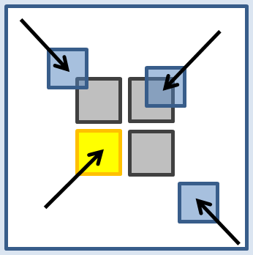
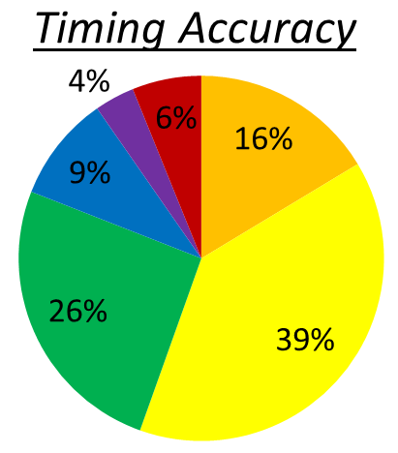
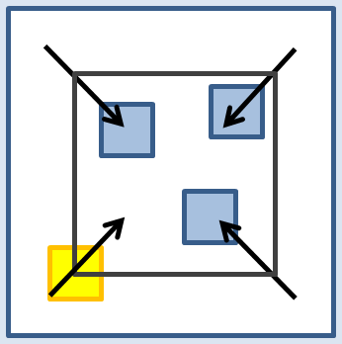
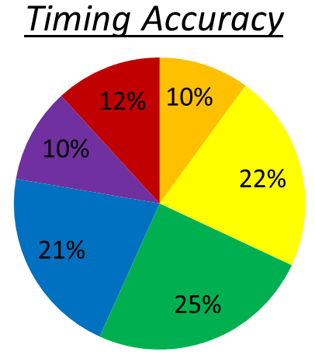
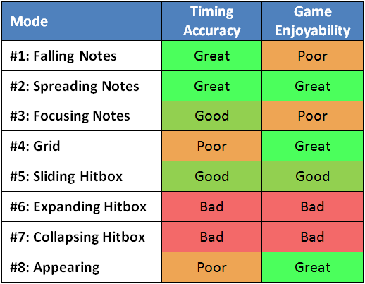
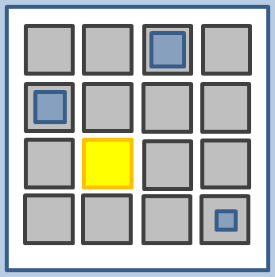
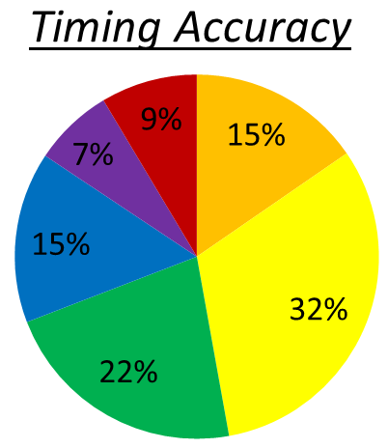
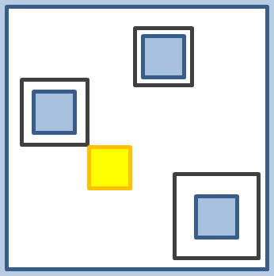
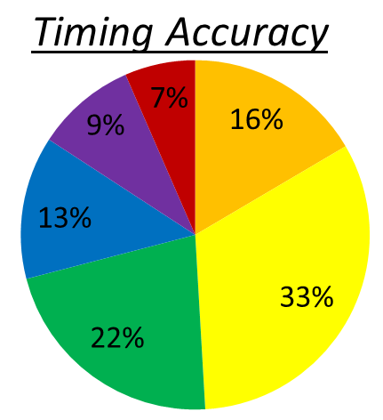


Designing Rhythm Game Interfaces for Touchscreen Devices
Philip Peng, Faculty Advisor: Stephen H. Lane
Design 1: Fall
http://beatsportable.com
https://play.google.com/store/apps/details?id=com.beatsportable.prototypes
Feedback:
Design 5: Slide
Feedback:
Category | Ratings | Avg
Challenge |  | 3.69
Intuitive |  | 4.18
Fun |  | 3.76
Unique |  | 2.43
Overall |  | 2.33
Abstract:
This project focuses on comparing different touchscreen interface designs for rhythm games. This is accomplished through the development of “Beats2 Prototypes”, a rhythm game for Android tablets, and analysis of collected gameplay data
Category | Ratings | Avg
Challenge |  | 4.39
Intuitive |  | 3.50
Fun |  | 4.07
Unique |  | 4.10
Overall |  | 3.80
Implementation:
Moving notes fall toward fixed hitboxes from top to bottom
Rhythm Games: Dance Dance Revolution, Guitar Hero, Beatmania IIDX
Moving hitbox fall toward fixed notes appearing from top to bottom
Rhythm Games: DJMax Technika
Design 2: Spread
Feedback:
Design 6: Expand
Feedback:
Category | Ratings | Avg
Challenge |  | 3.84
Intuitive |  | 3.94
Fun |  | 3.75
Unique |  | 3.97
Overall |  | 4.00
Fig 1. Screenshot of mode selection
Fig 2. Screenshot of gameplay
Category | Ratings | Avg
Challenge |  | 4.56
Intuitive |  | 2.84
Fun |  | 3.36
Unique |  | 4.54
Overall |  | 3.41
Moving notes slide toward fixed hitboxes from centre to corners
Rhythm Games: none
Expanding hitbox grows toward fixed notes from centre to corners
Rhythm Games: none
Design 3: Focus
Feedback:
Design 7: Collapse
Feedback:
Category | Ratings | Avg
Challenge |  | 3.79
Intuitive |  | 3.76
Fun |  | 3.42
Unique |  | 3.79
Overall |  | 3.54
Category | Ratings | Avg
Challenge |  | 4.26
Intuitive |  | 2.65
Fun |  | 3.04
Unique |  | 4.18
Overall |  | 3.23
Fig 3. App gameflow diagram
Fig 4. Timing accuracy chart
Moving notes slide toward fixed hitboxes from corners to centre
Rhythm Games: Gitaroo Man Lives!, Hatsune Miku: Project DIVA
Results:
Using collected data on accuracy charts and feedback ratings, the following relative ratings of each rhythm game mode were concluded:
Collapsing hitbox shrink toward fixed notes from corners to centre
Rhythm Games: none
Design 4: Grid
Feedback:
Design 8: Appears
Feedback:
Category | Ratings | Avg
Challenge |  | 4.27
Intuitive |  | 3.81
Fun |  | 4.14
Unique |  | 3.85
Overall |  | 3.98
Category | Ratings | Avg
Challenge |  | 3.93
Intuitive |  | 4.13
Fun |  | 4.33
Unique |  | 4.02
Overall |  | 4.20
Expanding notes grow in fixed hitboxes at grid points
Rhythm Games: jubeats
Collapsing hitboxes shrink around fixed notes appearing at grid points
Rhythm Games: Osu! Tatakae! Ouendan!
Senior Project Poster Day 2012 – Department of Computer and Information Science

